Slide 1
WELCOME TO OUR PROJECT
CALENDER

Slide 2
INDEX
t
Introduction
Problem Statement
Motivation
Objectivee of Projec
Supporting Literature
2.2 Algorithm of Propose Model
2.3 Flowchart of Propose model
1 Simple code for the project
3.2 Screenshot of the project
3.3 Limitation of the project
3.4 Reference

Slide 3
Introduction
Theoretical knowledge is not enough for a student. There is a difference between theoretical knowledge and practical development experiences. The most important purpose of a software development 1 program is to know about rules, regulation , and environment that an organization usually has. A software development 1 program will also help students to gather some experiences which help to achieve some arts to participate actively in the corporate world or in a real job field.
This report is being prepared as a requirement for the fulfilment of the software development 1 program at BUBT. The topic of this training and development program of Bangladesh University of Business and Technology(BUBT).
In our everyday life, we all have to go with the time and date. Without knowing the date we can’t walk a single. To maintain the timing sense, we must need a space of all dates(such as, normal dates, important dates, special dates etc.). So, calendar is that space where we can get all types of dates easily in sequence

Slide 4
Problem statement
We want to develop an application to make a calendar. We develop this Calendar using Structured programming language. Here, all dates , such as normal days, important days, special days will be shown.

Slide 5
motivation
Our respected course instructor Chairman Md. Saifur Rahman, Department of CSE, Bangladesh University of Business & Technology(BUBT). He first motivate us to create any application base project. Then we discuss with our team member and decide to develop a Calendar. Then our all team member learns about this project.

Slide 6
Objective of the project
Learn structure purpose
Learn struct part of C language

Slide 7
Propose Model
Structure data file
Pre define function
Void function
Constructor
For loop
Nested loop
Structure Calender
Main function
If-else if-else statement

Slide 8
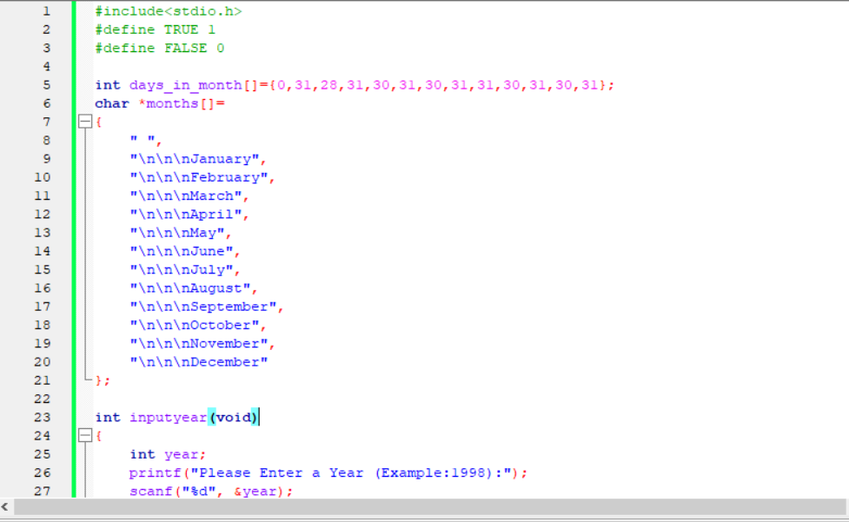
CONCLUSION
Simple code of the project
Sample#1

Slide 9
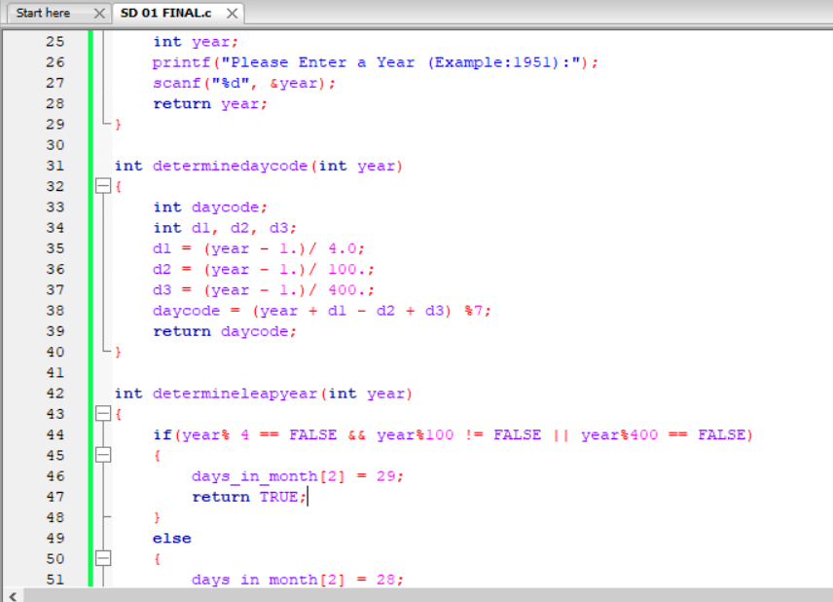

Slide 10
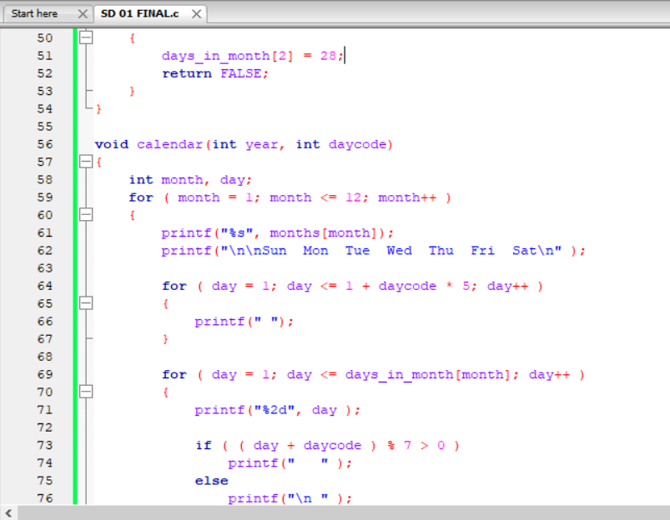

Slide 11
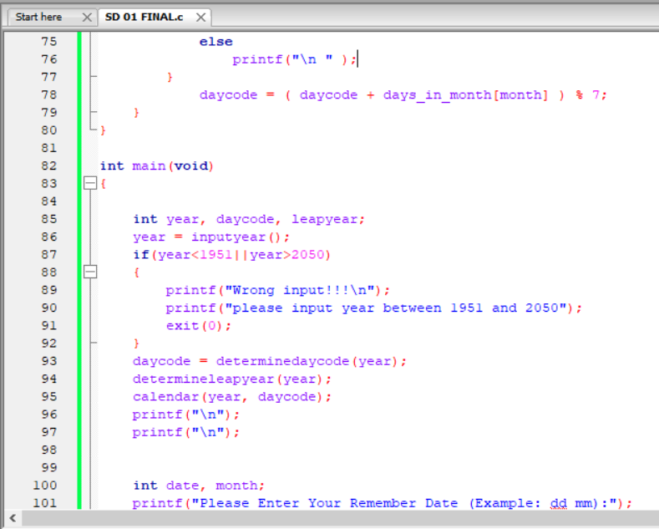

Slide 12
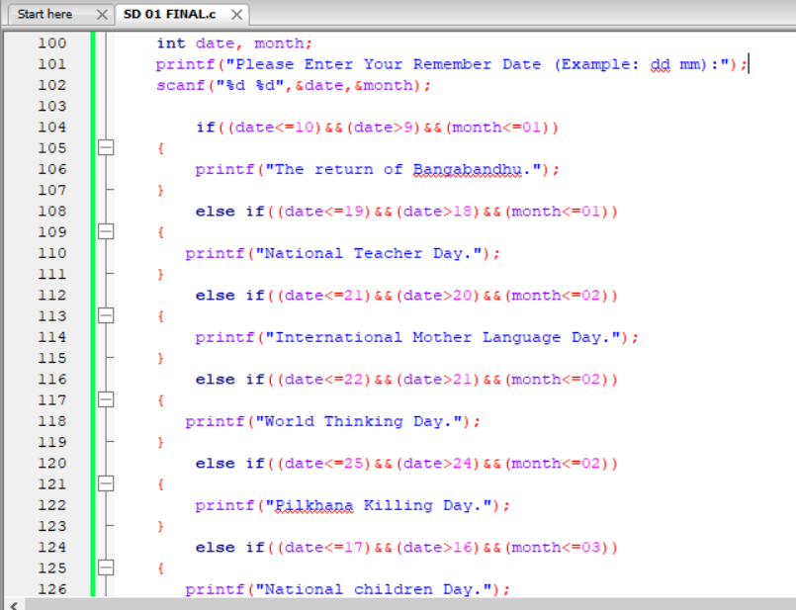

Slide 13
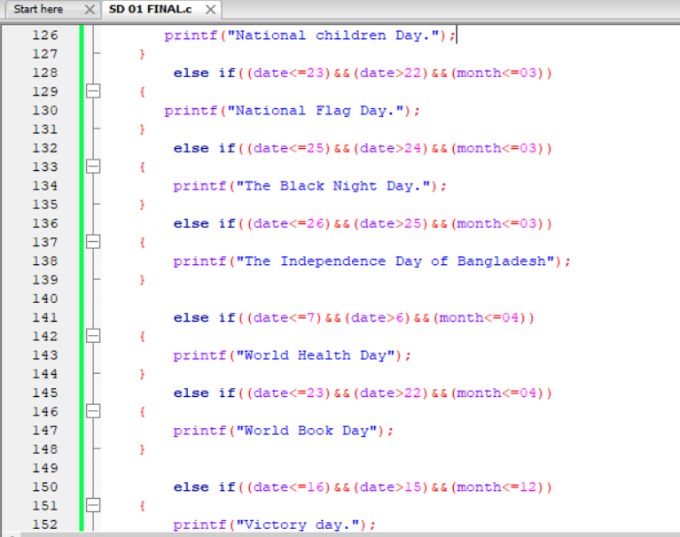

Slide 14
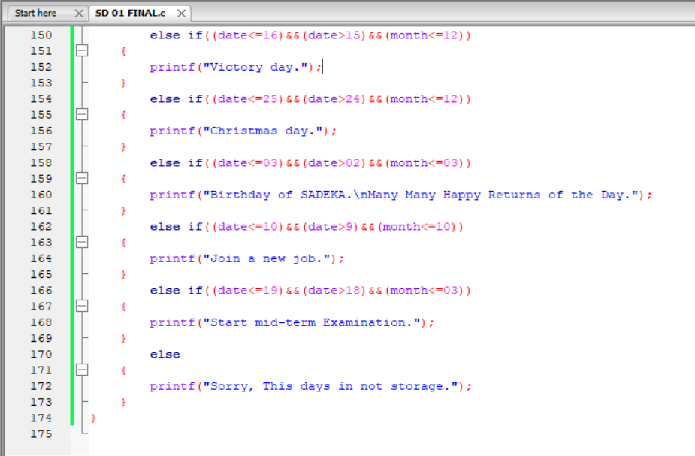

Slide 15
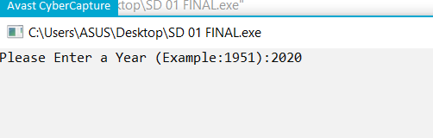
Screenshot of the output

Slide 16
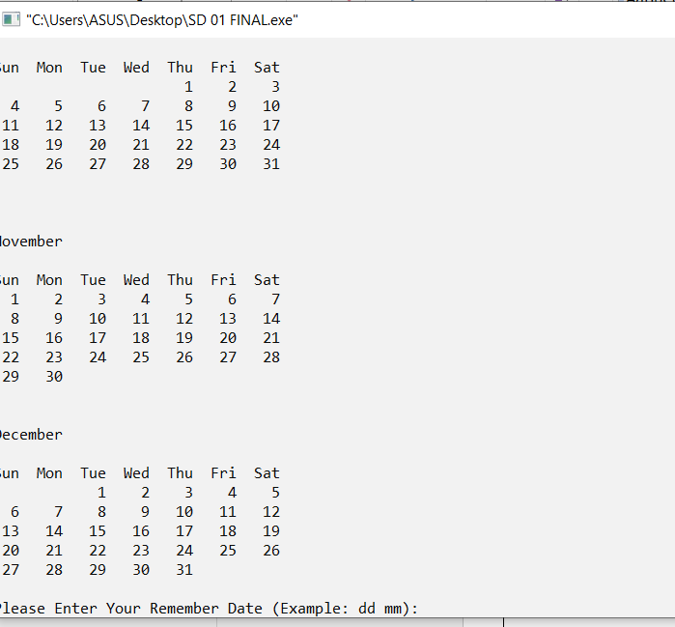
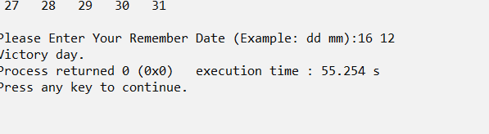

Slide 17
3.3 Limitation and Futurework :
Limitations:
It doesn’t contains all the data of each memorable day.
Probably, it has boundness. That’s why, it cann’t show all the inputed years of calender except the given values.
Futurework:
We should re-modify this to create a platform where we can easily find all the dates easily.
Auto share result in social media
3.4 References:
1. Wikipedia (Web Platform)
2. Stack Overflow (Web Platform)

